Slide 1
Spark/Cloud Foundry Project Build

Slide 2
Initial Setup
We assume prereq’s are done!
Git installed
Cloud Foundry CLI installed
Pivotal Web Services account created
Particle.io account created!
Create a new projects directory on your computer
Example c:\projects

Slide 3
Clone Git Repository
From the project directory, clone the devopsday git repo
git clone https://github.com/robnolen/devopsday.git

Slide 4
Configure Cloud Foundry Endpoint
From a terminal or command prompt, run
cf login -a https://api.run.pivotal.io
Log in with the PWS account you created earlier
Select your default organization

Slide 5
Explore the Python project folder
CD to the source directory
Procfile – tells Cloud Foundry how to run our app (our execution command)
Manifest.yml – describes services to be bound, buildpack, name
requirements.txt – list of python packages our application needs to run – gathered from pip freeze
main.py

Slide 6
Create Redis Service
Type cf services to see a list of pre-defined servies available – note many have a free tier
We need to create a rediscloud service
cf create-service rediscloud 30mb <servicename>
Update the manifest.yml with the name of the service you create

Slide 7
Push our app!
Now that we’ve created a redis service, and we have logged into CF, we should be able to push our application.
In your manifest.yml, edit the name attribute of your application, make it something unique
cf push
Browse to <yourapp>.cfapps.io

Slide 8
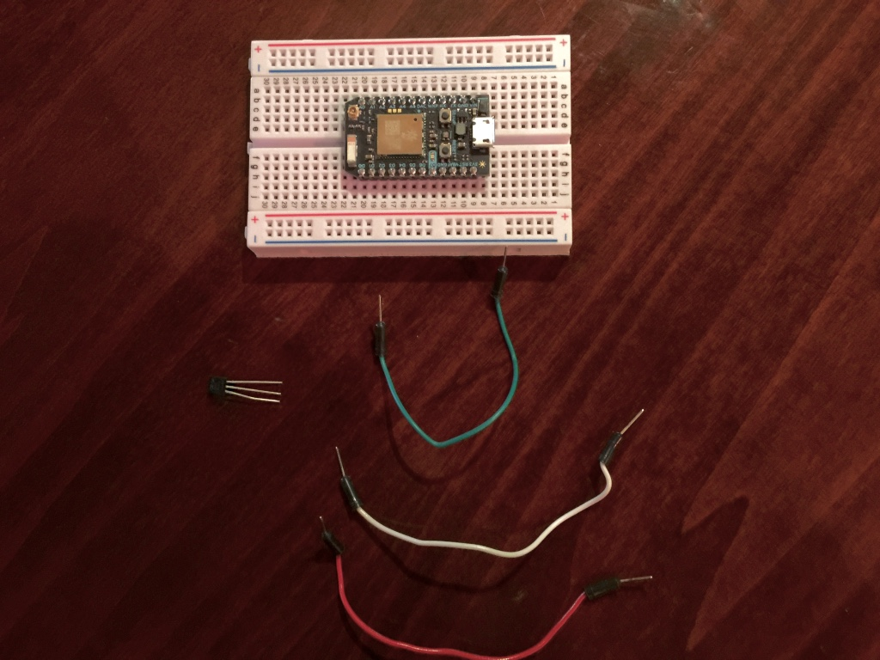
Explore your Photon
With your kit
Photon mounted on breadboard
LED/Photosensor/USB Cable, resistors
Separately – TMP36 Temperature sensor, jumpers (3)

Slide 9
Register/Pair your Photon
Use your iPhone (ask for USB registration steps if needed)
Download “Particle – Build with Photon, Electron & Spark Core”
Skip to Step 2 “Connect Your Photon”
Connect Photon to your computer using USB
Confirm blinking blue light
Using Mobile App
“Setup a Photon” Follow instructions
“Ready”
Connect to Photon Device (General.Wi-Fi. Photon-XXXX)
Connect the Photon device to wifi
Name device IE “shiveit_transponder”
Confirm the device shows up in your Particle app
Learn more @ www.spark.io/start

Slide 10
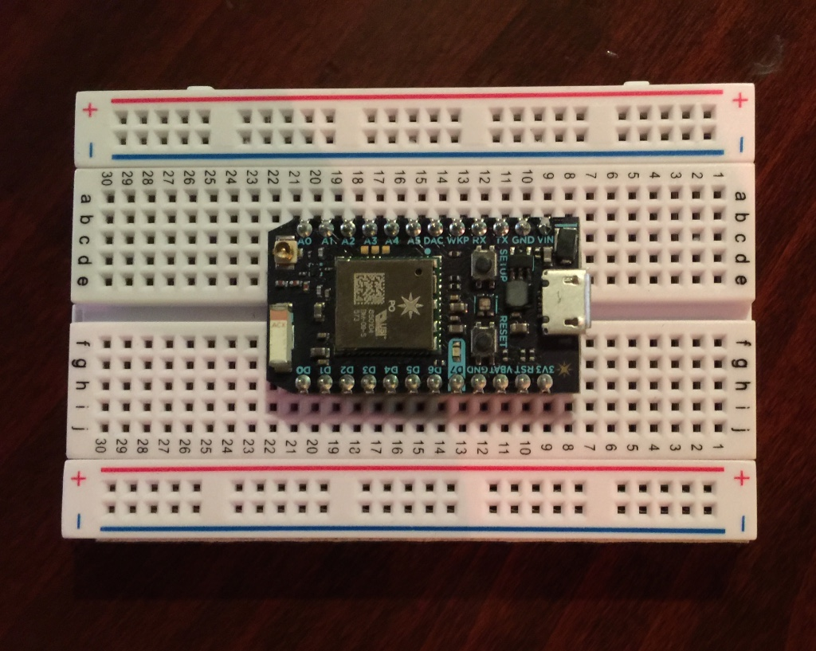
Orientation
First place your photon in front of you like this.
Note the columns and rows. These correspond to pins on the Photon
+/- are not used in this project.

Slide 11
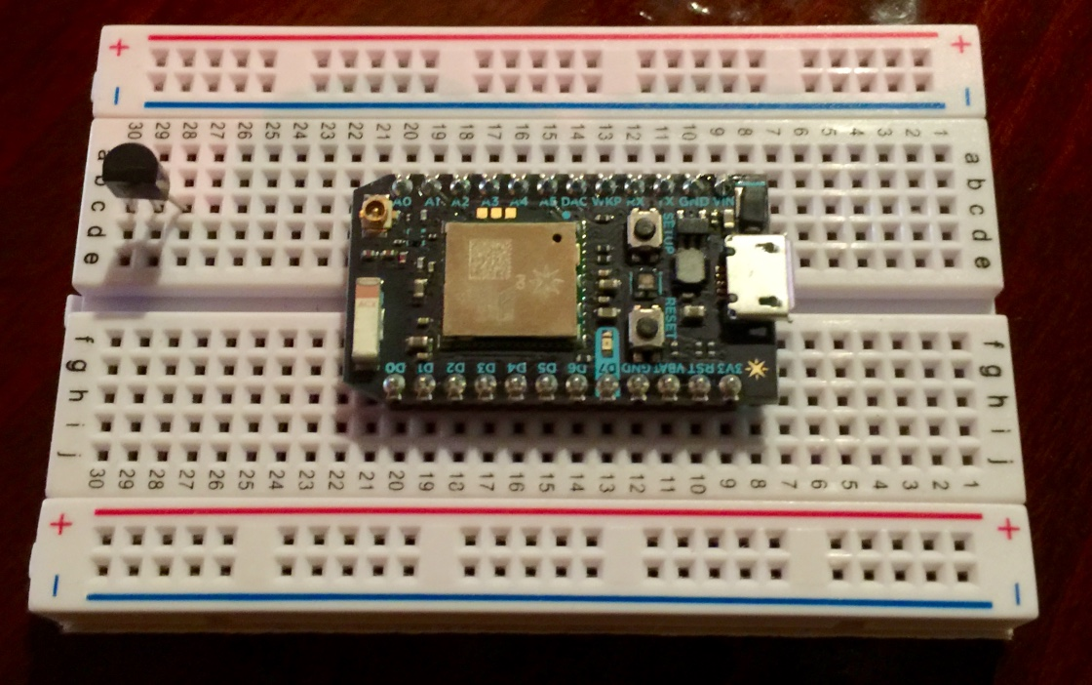
Connect Your TMP36
With the flat side facing you, place the TMP36 like shown in the photo. Each prong should be in a separate hole on the breadboard. Be gentle ☺

Slide 12
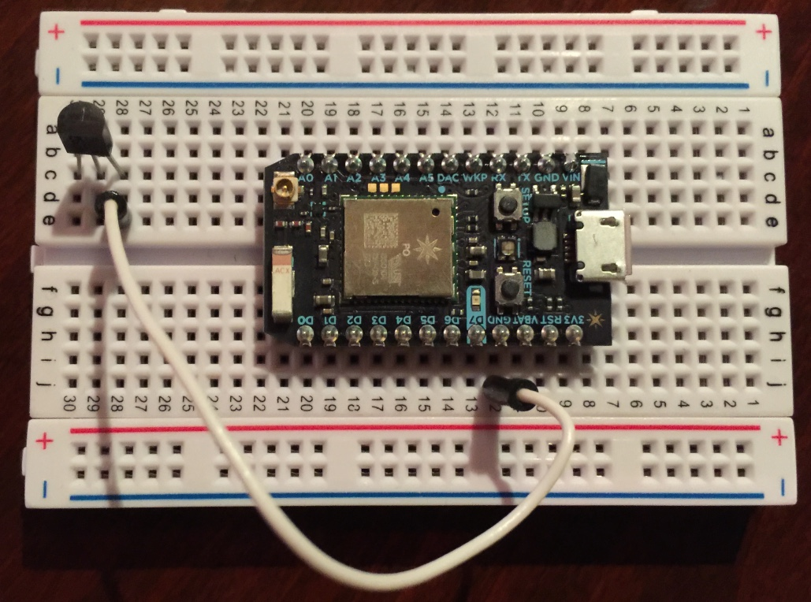
Connect to Ground
Connect the right pin to the ground on the Photon

Slide 13
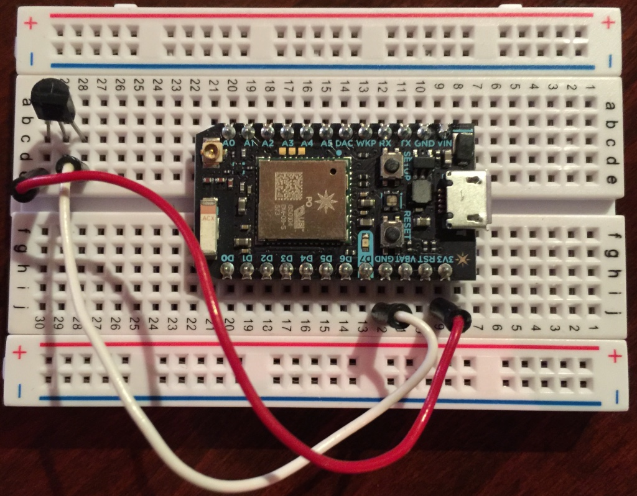
Connect to Power
Connect the left pin to the 3V3 (3 volt out) on the Photon

Slide 14
Power up the Photon
Connect USB power to the Photon
Wait for a aqua slow pulsating light
We’re now connected to Particle Cloud

Slide 15
Upload code to Photon
Open a browser and log into http://build.particle.io

Slide 16
Paste in the demo code
In the repository root, cd to the photon directory
Grab the C++ sourcecode and paste it into the editor
On line 15, modify the hostname to reflect the your Cloud Foundry app name

Slide 17
Include the HttpClient Library
We use a third party HTTP library for pushing data.
Click the ribbon icon to show the community libraries
Select HttpClient
Click Include in App

Slide 18
Flash your Photon
Click the checkmark inside the circle to verify your code is correct
Click the lightning bolt to flash your Photon
Photon will flash different colors, but go back to slow cyan when flash is done

Slide 19
Check your CF App
Once your Photon is slowly blinking cyan, it should be sending data to cloud foundry.
Browse to your app in your browser to see temperature data!

